Slide 1

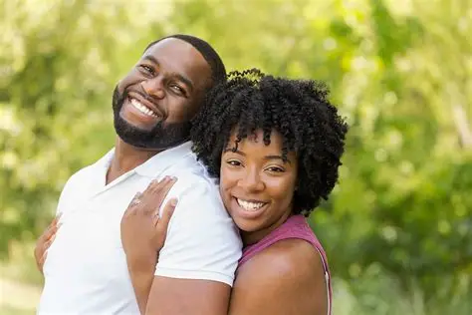





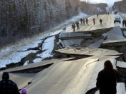
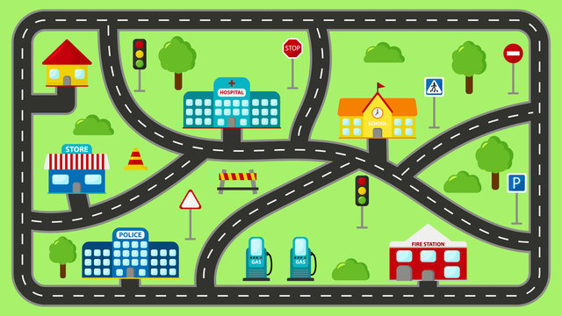

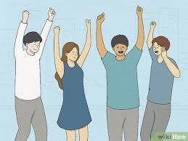

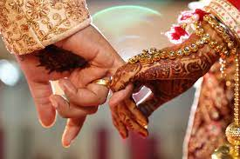



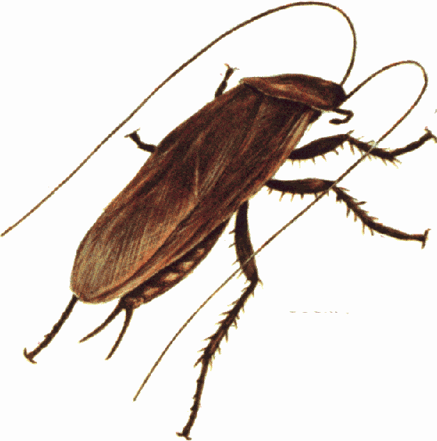

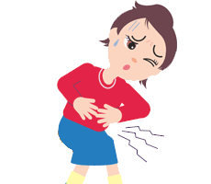



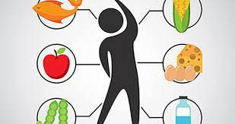

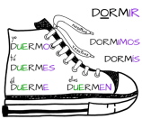
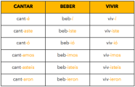








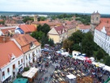



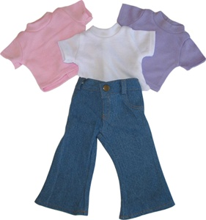
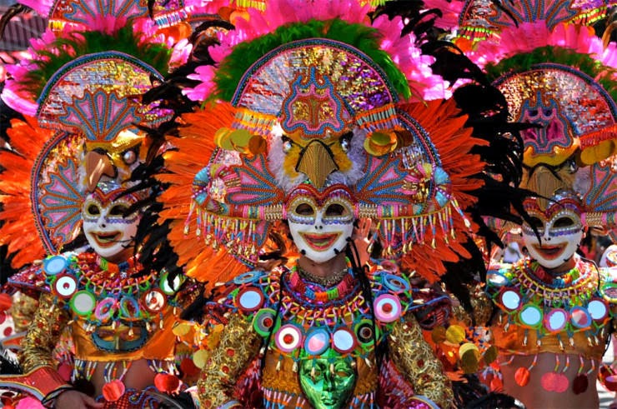





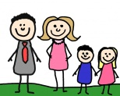






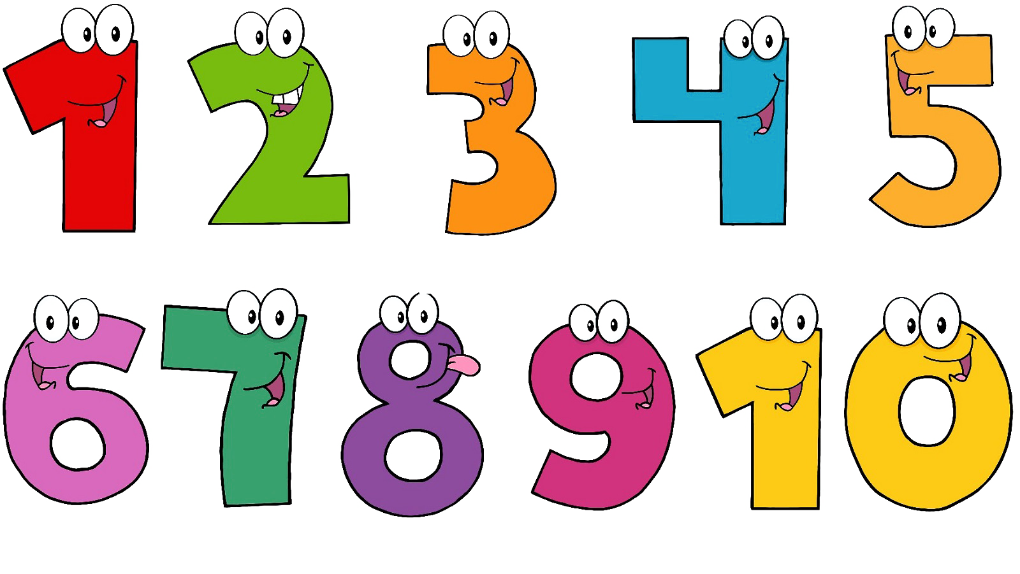






Spanish Learning Journey
Year 7
Understanding and Applying Language Skills
Year 11
Establishing pronunciation skills
Understanding key grammatical concepts
Applying grammatical knowledge – tense formation
Exploring tenses further
Exploiting reading skills
Enhancing writing skills
Developing speaking and listening skills
Expanding reading and writing skills
Widening vocabulary
Boosting listening skills
Honing speaking skills
Identity and relationships revision
Healthy living and lifestyle revision
Media and technology revision
Speaking revision and practice
Narrating future plans with
Timeframes.
REPASO
REPASO
REPASO
Exam & Post – 16
Destination
To describe Spanish festivals
CUSTOMS & FESTIVALS
Education and work revision
The environment and where people live revision
Revising the imperfect tense
Revising the conditional tense
Talking about social media and influencers
Talking about recycling
Revising the conditional and imperfect tense
Talking about natural disasters
Use of technology : Past , present and future.
Discussing lifestyle choices
YEAR
Talking about fame and its downsides
CELEBRITY CULTURE
11
EL MEDIO AMBIENTE
TECNOLOGIA
Using the imperfect , past and present
Talking about celebrity culture
Talking about the environment
Benefits and dangers of technology:
justifications
LA VIDA SANA
Describing a visit/ activities in the past
different jobs and work experience
Expressing emotions
Discussing partnerships and marriage
Destinations
Transport and weather
Talking about roles at work
Using three tenses together to give an account of a holiday.
Booking accommodation and dealing with problems
LAS RELACIONES
Do you lead an active lifestyle?
YEAR
EDUCACION Y TRABAJO
Relationship future plan
10
VACACIONES Y FESTIVALES
Talking about relationships issues
Reflexive verbs
Talking about diet
LOS VIAJES
Saying what job you would like to do
Using the conditional tense
plans for the future and gap years
Talking about festivals
Using imperfect and conditional tenses
MI SALUD
Talking about your daily routine
Discussing different types of entertainment
Giving complex opinions about subjects
school rules: modal verbs
Talking about my house and places in town
Using three tenses together
Talking about Myself and others
Talking about your family
Talking about ailments
Using irregular verbs in the present tense
Using reflexive, stem-changing and modal verbs
El OCIO
MIS ESTUDIOS
MI CASA Y MI PUEBLO
SOMOS ASI
Using adjective to talk about self
Sporting, outdoor activities and events
Using direct object pronouns
Making arrangements with friends
Subjects and teachers: use of comparatives and superlatives
Describing school, uniform and the school day
Describing the features of town/ a region
Verb ‘poder’
Talking about relationships
Talking about chores
YEAR
Saying what you did on holiday
Saying what you use your mobile phone for
Ordering a meal
9
Using the preterite tense
Music tastes
YEAR
Describing where you live
8
MIS VACACIONES
INTERESES
LA COMIDA Y FIESTAS
Planning for a party
Saying what your holiday was like
Conjugating past tense irregular verbs
Talking about TV
Using the near future tense
Saying what food you like
Talking about clothes and going out
Talking about festivals and celebrations
Asking for directions
MI CASA Y MI PUEBLO
Using – er and –ir present tense verbs
Describing your family
Saying when your birthday is
Classroom equipment and pets
Describing your school
Using adjectives to describe hair and eye colour
Saying what you can do in a town
YEAR
MI INSTI Y
MIS PASATIEMPOS
MI FAMILIA
MI VIDA
7
Saying what you do in your spare time
Talking about your personality
Talking about the weather
Giving opinions and justifications
Saying what subjects you study
Talking about age, brothers and sisters
Learning the alphabet, numbers and colours
Saying what sports you do
Using present tense –ar verbs
Introducing yourself

