Slide 1

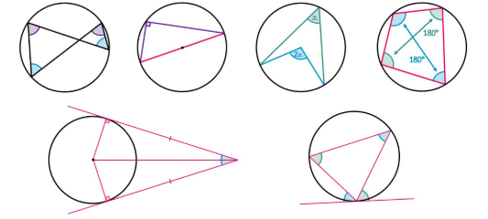
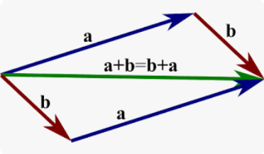

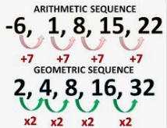
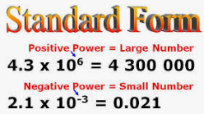
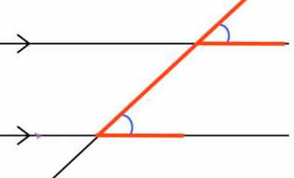



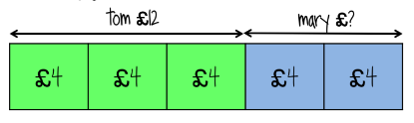
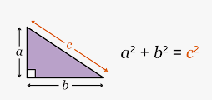
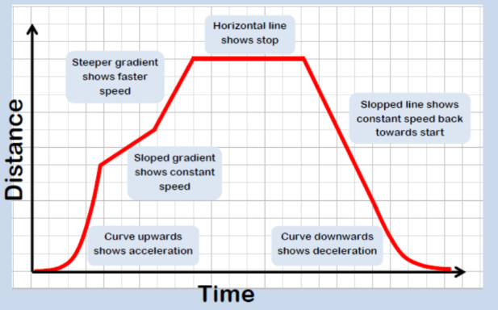
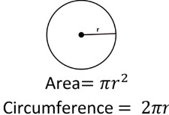
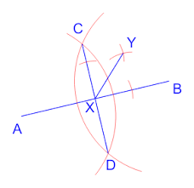

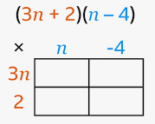
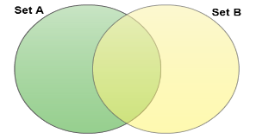

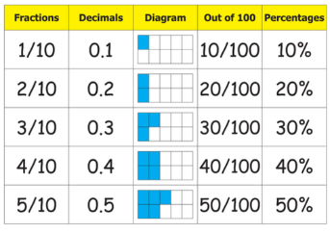
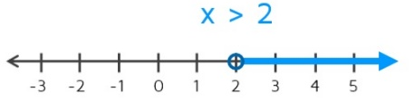
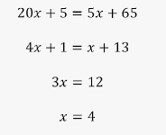
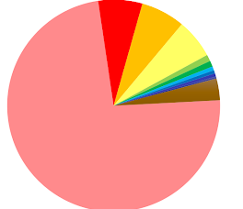
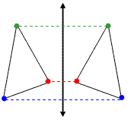
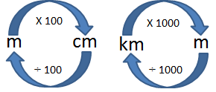
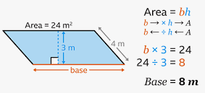
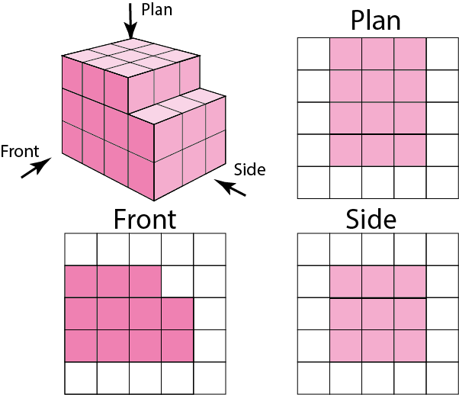
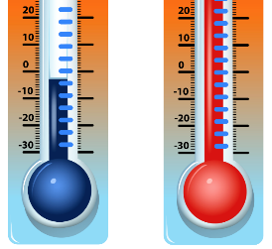
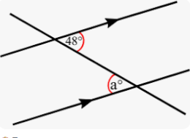

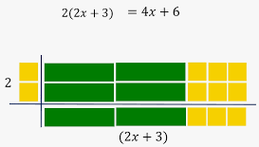

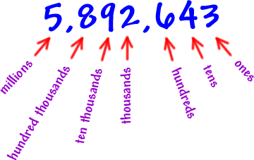
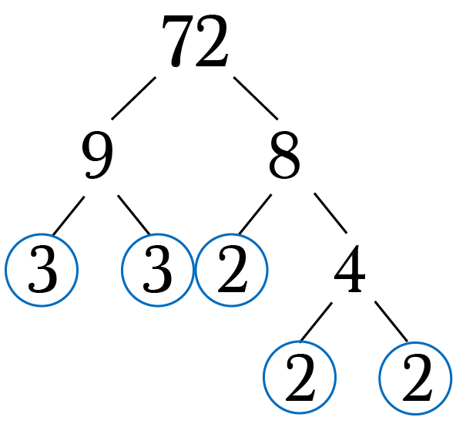
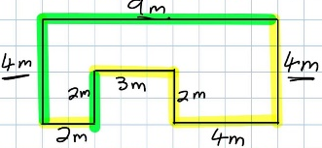

Mathematics
Higher Tier Learning Journey
2025-26
(Y11 following existing scheme)
Working mathematically:
- Develop fluency - Reason Mathematically - Solve problems
Year 7
Year 11
Become fluent in the fundamentals of mathematics
Solve problems with increasing sophistication
Extend and formalise knowledge
Extend fluency
Use mathematical language precisely
Solve multi-step problems
Begin to follow lines of enquiry
Reason deductively
Rearranging formulae
Functions
Solving geometric problems
Transformations with graphs
Exponential functions
Cubic functions
Circle theorem rules
Vector arithmetic
Simultaneous equations graphically
Circle theorems
More Algebra
Vectors & Geometric proof
Proportion and graphs
Exam & Post – 16
Destination
Equations and graphs
Application of circle theorem rules
Algebraic fractions
Proof
Solving quadratic equations graphically
Graphical inequalities
Surds
Vector notation
Direct and inverse proportion
Cumulative Frequency
Expanding triple brackets
Finding bounds for calculations
Sampling
Position to term
Cubic
BOXPLOTS
Indices of the form 1/a
Combining transformations
Direct proportion
Bias
Acceleration
Velocity graphs
Histograms
Further Statistics
Handling data and statistical diagrams
Converting fractions to recurring decimals
Reciprocal
11
Brackets
Recurring decimals
Indices
Rounding
Transformations
Proportion
Handling data
Sequences
Graphs
Changing
ratios
Sampling
YEAR
Ratio
Cumulative Frequency polygons
Completing the square
Recurring decimals to fractions
Indices of the form a/b
Inverse proportion
Combining ratios
Calculating with pressure
Estimating roots and powers
Geometric sequences
Compound measures
YEAR
Calculating with density
10
Volume of prisms
Algebraically
Angles of elevation and depression
Exact values
Independent events
Vectors
Constructing loci
Plotting real life graphs
Using venn diagrams
Tree diagrams
Dependent events
Data project:
Collect
Represent
Analyse
Interpret
HANDLING DATA, VECTORS
PERCENTAGES
Surface area and volume
Simultaneous equations
Formulae
Trigonometry
Constructions and Loci
Linear graphs
Set notation
Transforming shapes problems
Surface area of polyhedra
Graphically
Changing the subject
Using bearings
Equations of parallel lines
Using probability with venn diagrams
Using set notation
TRANSFORMATIONS, SIMILARITY & CONGRUENCY
Compound Interest
Growth and decay
Theoretical and experimental probability
Similarity problems
Equations of lines from graphs
Proportion word problems
Rearranging expressions
Length of arcs, volume of cylinders
Problem solving with Standard Form
QUADRATIC GRAPHS, ANGLES & BEARINGS
Linear inequalities
Percentage change
Identifying bearings
LINEAR GRAPHS, COMPOUND MEASURES AND MOTION-TIME GRAPHS
RATIO & PROPORTION
ROUNDING, 3D SHAPES & PYTHAGORAS’ THEOREM
FORMULAE, CONSTRUCTIONS & CIRCLES
INEQUALITIES & QUADRATIC EQUATIONS
PROBABILITY, STANDARD FORM
Problem solving with fractions and percentages
Plotting and interpreting Quadratic graphs
Angles in polygons
Speed and rates problems
Speed, Distance, Time graphs
Solving Quadratic equations
FRACTIONS & PERCENTAGES
Constructing bisectors
YEAR
9
BRACKETS, ALGEBRAIC FRACTIONS & RECURRING DECIMALS
YEAR
Fractional Increase and decrease
Index laws
Significant figures
Coordinates and midpoints
Surface Area of prisms
Recurring decimals
8
Problem solving
Theoretical Probability
Sequence rules
Introduction to Standard Form
Plotting graphs
STATISTICAL DIAGRAMS & INEQUALITIES
Calculating with fractions
PROPORTION INVOLVING FRACTIONS, DECIMALS & PERCENAGES
PROBABILITY
PERCENTAGES & MONEY
INDICES, EQUATIONS SEQUENCES & RATIO
ROUNDING, COORDINATES, AREAS & CIRCLES
STANDARD FORM, VENN DIAGRAMS, 3D SHAPES
SURFACE AREA AND VOLUME
LINEAR GRAPHS, TRANSFORMATIONS AND ANGLES
HANDLING DATA AND STATISTICAL DIAGRAMS
Reverse fractions of amount
Percentage change
Calculating with money
Areas of parallelograms and trapeziums
Constructing nets
Volume of prisms
Enlargements
Rotations
Averages and range
Solving Equations with variables on both sides
Identifying and estimating
ANGLES
Calculating angles
Rounding
Add, subtract fractions
Converting units of length
Inequality symbols
Translations
Names of lines
BRACKETS
Finding prime numbers
Shape properties
Substitution
Reflections
YEAR
Expanding and factorising with single brackets
FRACTIONS
FACTORS, MULTIPLES & PRIMES
PERIMETER, AREA AND COORDINATES
2D SHAPES
MEASURES
EXPRESSIONS &
EQUATIONS
NUMBER SENSE & CALCULATIONS
7
Comparing fractions
Identifying HCF, LCM
Perimeter and area of rectangles & triangles
Line properties
Estimating
Ordering fractions
Forming expressions
Solving Equations
Ordering integers and decimals
Labelling place value
Multiplying and dividing negative numbers

