Slide 1


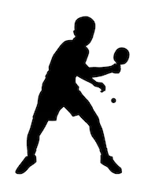

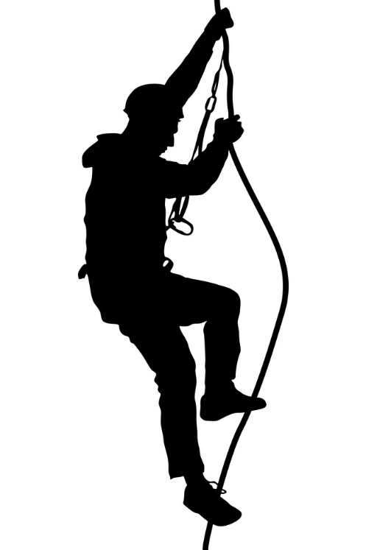

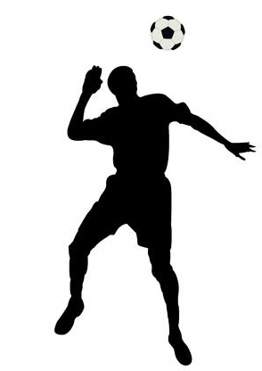

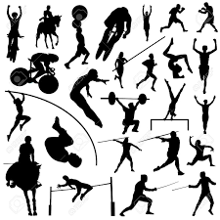
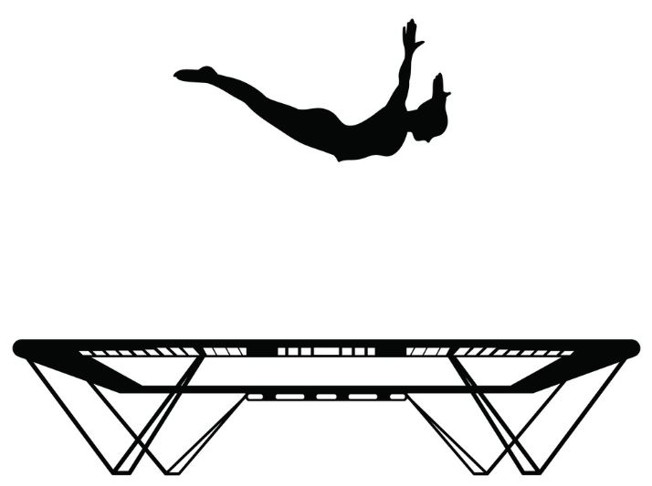
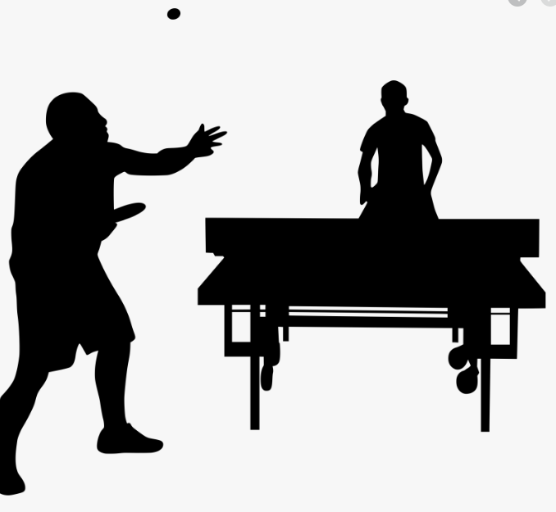

GCSE PE
Learning Journey
Year 9
PRACTICAL SKIILS AND APPLICATION
Year 11
Skills
Techniques
Unopposed
Competitive
Tactics
Strategies
Paper 2 Topic 1
Paper 1 Topic 2
Practical Moderation
Paper 2 Topic 2
Paper 1
Practical Exam Preparation
REVISION AND PRACTICAL EXAMS
POST 16 Destination
Paper 1 Topic 3
Paper 1 Topic 1
Paper 2 Topic 3
Paper 2
Respiratory
system
MOVEMENT ANALYSIS
Planes
Ethical and socio- cultural issues
Types of feedback
Goal setting SMART
Classification of skills
Long term effects of exercise
Levers
Types of guidance
Aerobic / anaerobic
Group 2 Activity skills and application
SOCIO-CULTURAL INFLUENCES
SPORTS PSYCHOLOGY
Cardiovascular system
Engagement patterns
Practice structures
Short Term Effects of Exercise
APPLIED ANATOMY AND PHYSIOLOGY
Commercialisation
6 Week Programme
Lungs
Team Game skills and application
Personal Exercise Programme
Heart
Long term
Benefits of training
Plan
Warm up
Fibres
Skeleton & Muscles
Antag-onistic Pairs
PED’s
YEAR
RICE
YEAR
11
Weight / resistance training
THE EFFECTS OF EXERCISE
COMPONENT 4
INJURIES
APPLIED ANATOMY AND PHYSIOLOGY
Interval training
Coursework write up
Prevention
Cool down
Ligaments
Short term
Use of data
Types of injury
Joints
Tendons
Progressive overload
Individual needs
Fitness Tests
Reaction
time
Circuit training
TRAINING METHODS
Plyometrics
Target zone
FITT
Power
Agility
Speed
Fartlek training
Body Composition
PRINCIPLES OF TRAINING
SKILL RELATED FITNESS
Muscular Endurance
Continuous training
HEALTH RELATED FITNESS
Flexibility
Group 2 Activity skills and application
Thresholds of training
Reversibility
Specificity
How to improve fitness
Balance
Coordination
Cardiovascular fitness
Sex
Height
Bone Structure
Correct energy balance
Importance of water
Strength
Exercise and performance
Protein for power
OPTIMUM WEIGHT
ENERGY BALANCE AND HYDRATION
PHYSICAL TRAINING
Components of fitness
Group 2
Activity skills and
application
Carbo-loading
Muscle girth
Suitability for sport
Kilojoules and calories
Effects of dehydration
Team Game skills and application
Fitness and health
ENERGY USE, DIET, NUTRITION
Macronutrients
Physical Health
Team Game skills and application
Diabetes
High Blood Pressure
Obesity
Smoking alcohol
Lifestyle choices
Social Health
YEAR
SEDENTARY LIFESTYLE
HEALTH FITNESS AND WELL BEING
10
Balance Diet
Coronary Heart Disease
Depression
Diet, sleep activity, drugs
Impact of fitness on well -being
Bridging course- Antatomy
Osteoporosis
Emotional Health

