Slide 1









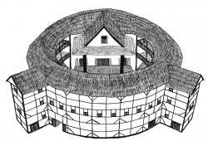




















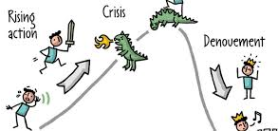


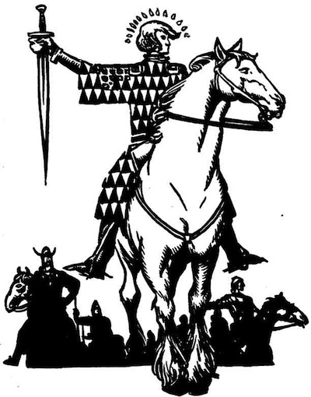

English & English Literature
Learning Journey
Year 7
Reading and Writing Skills
Year 11
Access challenging and knowledge rich literature
Develop story writing and argument skills
Reading of diverse texts exploring current issues
Analyse writer’s craft of structure, language, metaphor and imagery
Develop spoken language skills
Understanding of the influence of context on a writer
Identify and comment perceptively on many elements of a text
Develop appreciation of writer’s craft
Write with confidence and skill
Revise all Paper 2 elements:
Language
Summarise differences
Compare viewpoints
Persuasive writing
Revise all reading elements of English Language:
Language
Structure
Evaluation
Summarise Differences
Compare Viewpoints
Revise all writing elements of English Language:
Ideas and Content
Planning
Structure and Organisation
Sentence Structures
Vocabulary
Spelling and Punctuation
REVISING READING
QUESTIONS AND POETRY
Exam & Post – 16
Destination
REVISING PAPER 2 AND MACBETH
REVISING WRITING QUESTIONS AND A CHRISTMAS CAROL
Revise all elements of plays:
Plot/Character
Quotations
Language/Structure
Themes/Purpose
Exam Technique
Revise all elements of poetry analysis:
Language/Form/Structure
Poetry-specific terminology
Comparison of poems
Exam Technique
Revise all elements of the novel:
Plot/Character
Quotations
Language/Structure
Themes/Purpose
Exam Technique
Revise all Paper 1 elements:
Language
Structure
Evaluation
Creative writing
REVISING PAPER 1 AND AN INSPECTOR CALLS
Summarise differences and viewpoints in texts
Comment on language and structure
Study the context of each poem
Perform a speech on a theme in the play
Comment on language and structure
Read the play and study plot
and character
YEAR
WRITERS’ VIEWPOINTS
AND PERSPECTIVES
11
POETRY: POWER AND CONFLICT
MODERN PLAY:
AN INSPECTOR CALLS
Learn about Shakespearean England
Comment on language
(15 poems studied throughout the year)
Compare writers’ viewpoints
Persuasive Writing
Look at author’s purpose and themes
Compare poems
Look at author’s purpose and themes
Explore themes such social responsibility
Revise poetry-specific terms
MACBETH
Create a video essay and a zine
Comment on language and structure
Evaluate a writer’s use of methods
Read the novel and study plot
and character
Study Victorian context
Explore extracts in detail
Study Key Scenes
Read lesser known works of fiction from different voices
YEAR
YEAR
10
CREATIVE READING
AND WRITING
19TH CENTURY NOVEL:
A CHRISTMAS CAROL
Explore themes such as guilt and ambition
Analyse non-canonical literature
POWER AND VOICE
Creative Writing
Focus on using vocabulary and methods
Look at author’s purpose and themes
Comment on language and structure
Explore themes such as poverty and redemption
Consider power and privilege
Compare writers’ viewpoints
Plan creative writing
CREATIVE WRITING
Comment on language and structure
Look at author’s purpose and themes
Creative Writing
Explore extracts in depth
Study Key Scenes
Learn about Elizabethan society
Analyse characters and their relationships
Explore themes such as conflict and racism
Explore how to write within genre
SHERLOCK HOLMES
DARK FICTION
ROMEO AND JULIET
Big Write - essay
Explore genre and character
Study Victorian context
Comment on language and structure
Explore themes such as conflict and love
Comment on language and structure in key scenes
Read Shakespearean English
NOUGHTS AND CROSSES
Revise poetry-specific terms
Comment on language and structure
YEAR
9
YEAR
Big Write - essay
Explore writer’s purpose through allegory
Study a modern play
Explore themes of social class and inequality
Reading poems from other cultures
Consider politics in the modern world
YEAR
Read a range of texts
Throughout Year 7 and Year 8, students have weekly Library lessons. During these they are taught explicit literacy skills and take part in reading fiction and non fiction texts.
8
BETTER WORLD
Explore the refugee crisis
DYSTOPIA
ANIMAL FARM
BLOOD BROTHERS
POETRY AND SOCIETY
DESCRIBING
PLACE
BETTER WORLD
Read and perform speeches
Explore genre conventions
Creative writing skills
Consider functional societies
Comment on language
Analyse characters and their relationships
Explore perspective in poetry
Analyse poetry and writer’s intenton
Big Write – description
Develop descriptive writing skills
Spoken Language skills
BOY 87
Explore themes of freedom and courage
Spoken Language skills
Plot character development in texts
Read feminist literature
Explore comedy in Shakespeare’s plays
Introduction to essay writing skills
Explore the structure of a story
Consider narrative perspective
YEAR
YEAR
GOTHIC WRITING
SPEAK OUT POETRY
WOMEN IN LITERATURE
A MIDSUMMER NIGHT’S DREAM
HEROES, MYTHS AND LEGENDS
7
Big Write – story
Analyse features of the gothic genre
Take part in poetry writing and performance
Consider stereotypes and the concept of gender
Read Shakespearean English
Make inferences and comment on characters
Analyse mythical characters
Big Write - essay

