Slide 1

Parent Forum
On-Line Safety Information
If you believe, you can achieve

Slide 2


On-Line Safety
Why?
  Young people have unprecedented access to digital devices and the digital world.
  Access to the digital devices is now considered as essential as running water and electricity
  Increasing number of incidents involving misuse of digital devices or exploitation of young people online.
If you believe, you can achieve

Slide 3
On-Line Safety at The Barlow
On-Line Safety Policy including Acceptable Use for students and staff – just like any organisation.
Digital Literacy (inc. E-Safety) covered in the core Computer Science curriculum (Y7/8)
On-Line Safety high profile part of the RICH Study programme and assemblies throughout the year
If you believe, you can achieve

Slide 4
The Four C’s
CONTACT – Who they talk to
CONDUCT – How they behave
CONTENT – What they access
CONTRACT – Children may be exploited by potentially harmful contract.
We must all work in partnership at home and in school to ensure students are well informed and make appropriate decisions when operating
‘online’
If you believe, you can achieve

Slide 5
The Research - NSPCC
Risks
Cyberbullying
Grooming
Inappropriate websites
Losing control of pictures
Online reputation
Viruses, hacking and security
60% of teens surveyed said they had been asked for sexual images or videos
40% said they had created a sexual image
or video
25% said they had sent one to someone by text
33% said they had sent it to someone they knew online but had never met
15% said they had sent it to a complete stranger
If you believe, you can achieve

Slide 6




if you believe, you can achieve

Slide 7
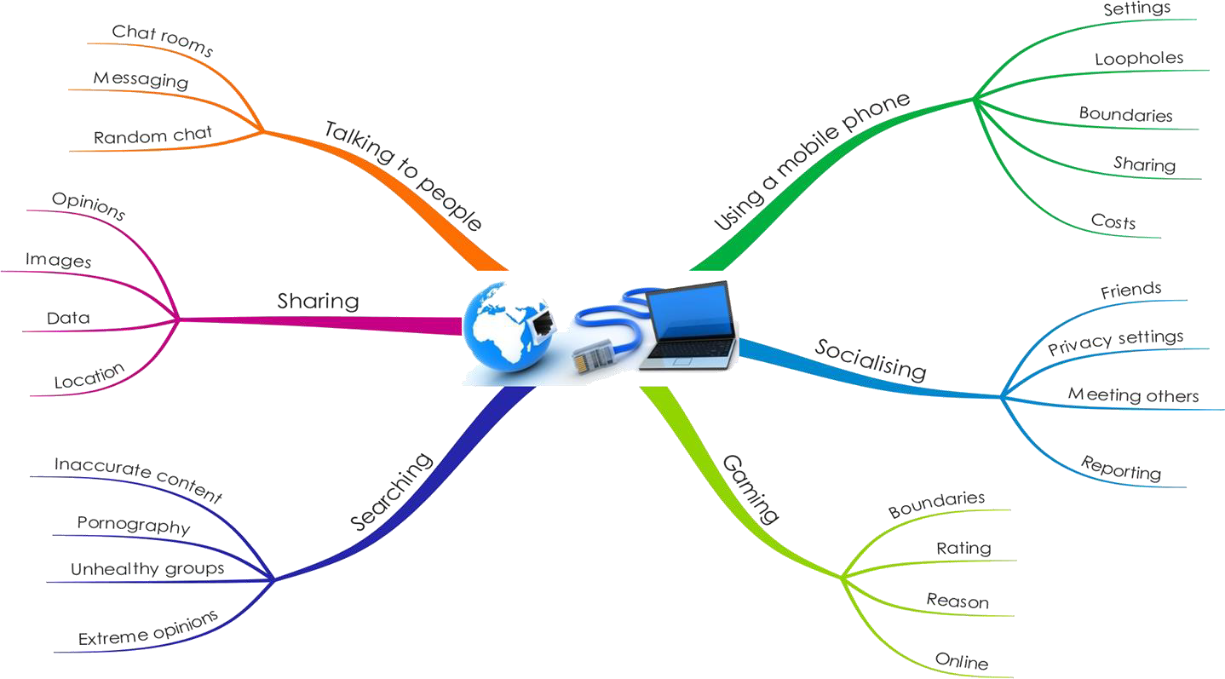





Online challenges
if you believe, you can achieve

Slide 8

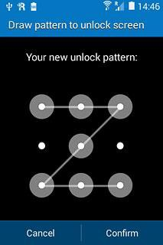

Mobile phone – Key questions
What can their phone do? Most phones are capable of accessing the Internet including social media, running apps, games, sharing locations, chat, message, taking photos and videos …
Do they keep their information private?
Are they clear what they can/cannot share?
Do they know what to do if something goes
wrong?

Slide 9
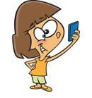


Sharing– Key questions
What images do they share? Do they share pictures or videos?
What opinions do they share? Are they always considerate of their audience?
What personal information do they share? Are they clear about what is appropriate?
Do they share their location? Do they need to let others know where they are?

Slide 10




Socialising – Key questions
Do you know what sites they have accounts for and do they who their ‘friends’ are in real life?
Do they know how to change their privacy
settings – and are they secure?
Would they ever agree to meet up with someone from a social network?
Do they know what to do if someone
upsets them?

Slide 11



Gaming – Key questions
What is the age range for the game? Is it suitable?
Why do they like playing it? Which of their friends play it?
Are they part of an online community? Do they know the other people?
What boundaries have you set?
Do they know what to do if someone
upsets them?

Slide 12
Searching on the web
Likely that many teenagers will:
Come across content that may upset or frighten them
See pornographic images online
Find web sites with extreme views
Read information online that is not true
Find web sites that reinforce negative behaviours

Slide 13
Risks
Cyberbullying
Grooming
Inappropriate websites
Losing control of pictures
Online reputation
Viruses, hacking and security

Slide 14

Our system
Filtered – Internet is filtered
Safe search – activated
Monitored – daily reports
Individual logins
Individual email accounts
Staff training

Slide 15
Your Control…
Curfews – No Access to Devices at bedtimes.
Students will stay up ‘past bed time’ on apps. Take phones or controllers off them before bed.
Visit Think-U-Know website for parent information – it is
REALLY good
Be Open and Honest, Check your child’s phone and make this a matter of routine. You will soon be aware if there is anything troubling them.

Slide 16
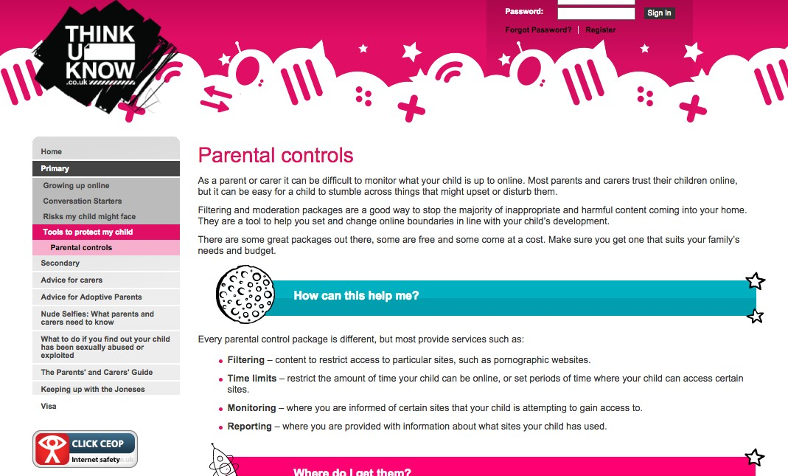
https://www.thinkuknow.co.uk/parents/Primary/Tools/Par ental-controls/
if you believe, you can achieve

Slide 17



Slide 18
More information?
www.thinkuknow.co.uk
www.childline.org.uk
www.childnet.com
www.ceop.police.uk
www.familiesmatter.org.uk

